Slide 1
Sociology Course Code (SS 2005)
Muhammad Zeeshan

Slide 2
SOCIAL GROUP AND ITS TYPES
A social group is two or more people who identify with and interact with one another.
Not every collection of individuals forms a group. People all over the country with a status in common, such as women, homeowners, soldiers, millionaires, college graduates and are not a group but a category.
Primary group a small social group whose members share personal and lasting relationships e.g. family.
Secondary group a large and impersonal social group whose members pursue a specific goal or activity for e.g. office colleagues.

Slide 3
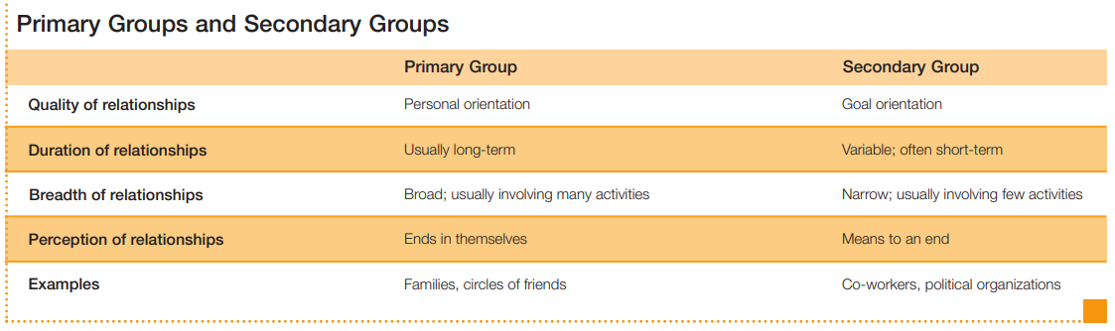

Slide 4
GROUP LEADERSHIP
Two Leadership Roles
Groups typically benefit from two kinds of leadership.
Instrumental leadership refers to group leadership that focuses on the completion of tasks. Members look to instrumental leaders to make plans, give orders, and get things done.
Expressive leadership, by contrast, is group leadership that focuses on the group’s well-being. Expressive leaders take less interest in achieving goals than in raising group morale and minimizing tension and conflict among members.

Slide 5
THREE LEADERSHIP STYLES
Sociologists also describe leadership in terms of decision-making style.
Authoritarian leadership focuses on instrumental concerns, takes personal charge of decision making, and demands that group members obey orders. Although this leadership style may win little affection from the group, a fast-acting authoritarian leader is appreciated in a crisis.
Democratic leadership is more expressive and makes a point of including everyone in the decision-making process. Although less successful in a crisis situation, democratic leaders generally draw on the ideas of all members to develop creative solutions to problems.
Laissez-faire leadership allows the group to function more or less on its own (laissez-faire in French means “leave it alone”). This style is typically the least effective in promoting group goals (White & Lippitt, 1953; Ridgeway, 1983).

Slide 6
GROUP CONFORMITY
Groups influence the behavior of their members by promoting conformity.
“Fitting in” provides a secure feeling of belonging, but at the extreme, group pressure can be unpleasant and even dangerous.
As experiments by Solomon Asch and Stanley Milgram showed, even strangers can encourage conformity.

Slide 7
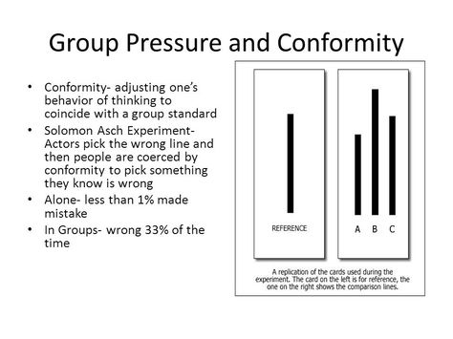

Slide 8
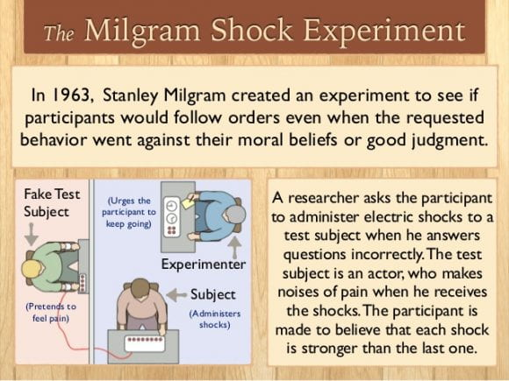

Slide 9
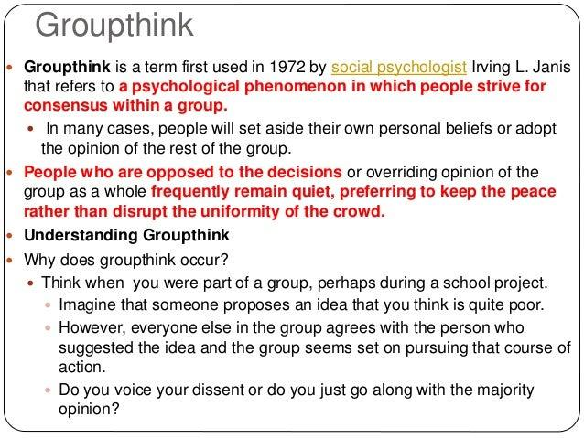

Slide 10
TYPES OF GROUPS
A reference group, a social group that serves as a point of reference in making evaluations and decisions.
An in-group is a social group toward which a member feels respect and loyalty. An in group exists in relation to an out-group,
Out-group is a social group toward which a person feels a sense of competition or opposition. In-groups and out-groups are based on the idea that “we” have valued traits that “they” lack.
Social Diversity Cultural differences between people of diverse cultural backgrounds living in a specific area.

Slide 11
GROUP SIZE
Simmel (1950, orig. 1902) used the term dyad (Greek for “pair”) to designate a social group with two members
Simmel also studied the triad, a social group with three members, which contains three relationships, each uniting two of the three people
A network is a web of weak social ties. Think of a network as a “fuzzy” group containing people who come into occasional contact but who lack a sense of boundaries and belonging.

Slide 12
FORMAL ORGANIZATIONS AND ITS TYPES
Formal organizations, large secondary groups organized to achieve their goals efficiently
Types of Formal Organizations
Amitai Etzioni (1975) identified three types of formal organizations,
Utilitarian Organizations: an organization, one that pays people for their efforts. Large businesses, for example, generate profits for their owners and income for their employees.
Normative Organizations: People join not for income but to pursue some goal they think is morally worthwhile. Sometimes called voluntary associations, these include community service groups as well as political parties and religious organizations.
Coercive Organizations: Membership in coercive organizations is involuntary. People are forced to join these organizations as a form of punishment (prisons) or treatment (some psychiatric hospitals).

Slide 13
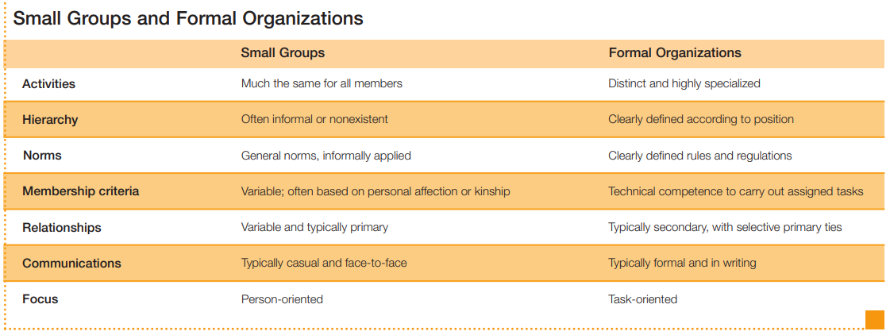

Slide 14
BUREAUCRACY, ITS CHARACTERISTICS AND PROBLEMS
Bureaucracy is an organizational model rationally designed to perform tasks efficiently. Bureaucratic officials regularly create and revise policy to increase efficiency
Characteristics:-
Specialization.
Hierarchy of positions.
Rules and regulations.
Technical competence.
Impersonality.
Formal, written communications.
Problems of bureaucracy
Bureaucratic alienation
Bureaucratic inefficiency and ritualism
Bureaucratic inertia
Oligarchy

Slide 15
Q&A Session

